Slide 1
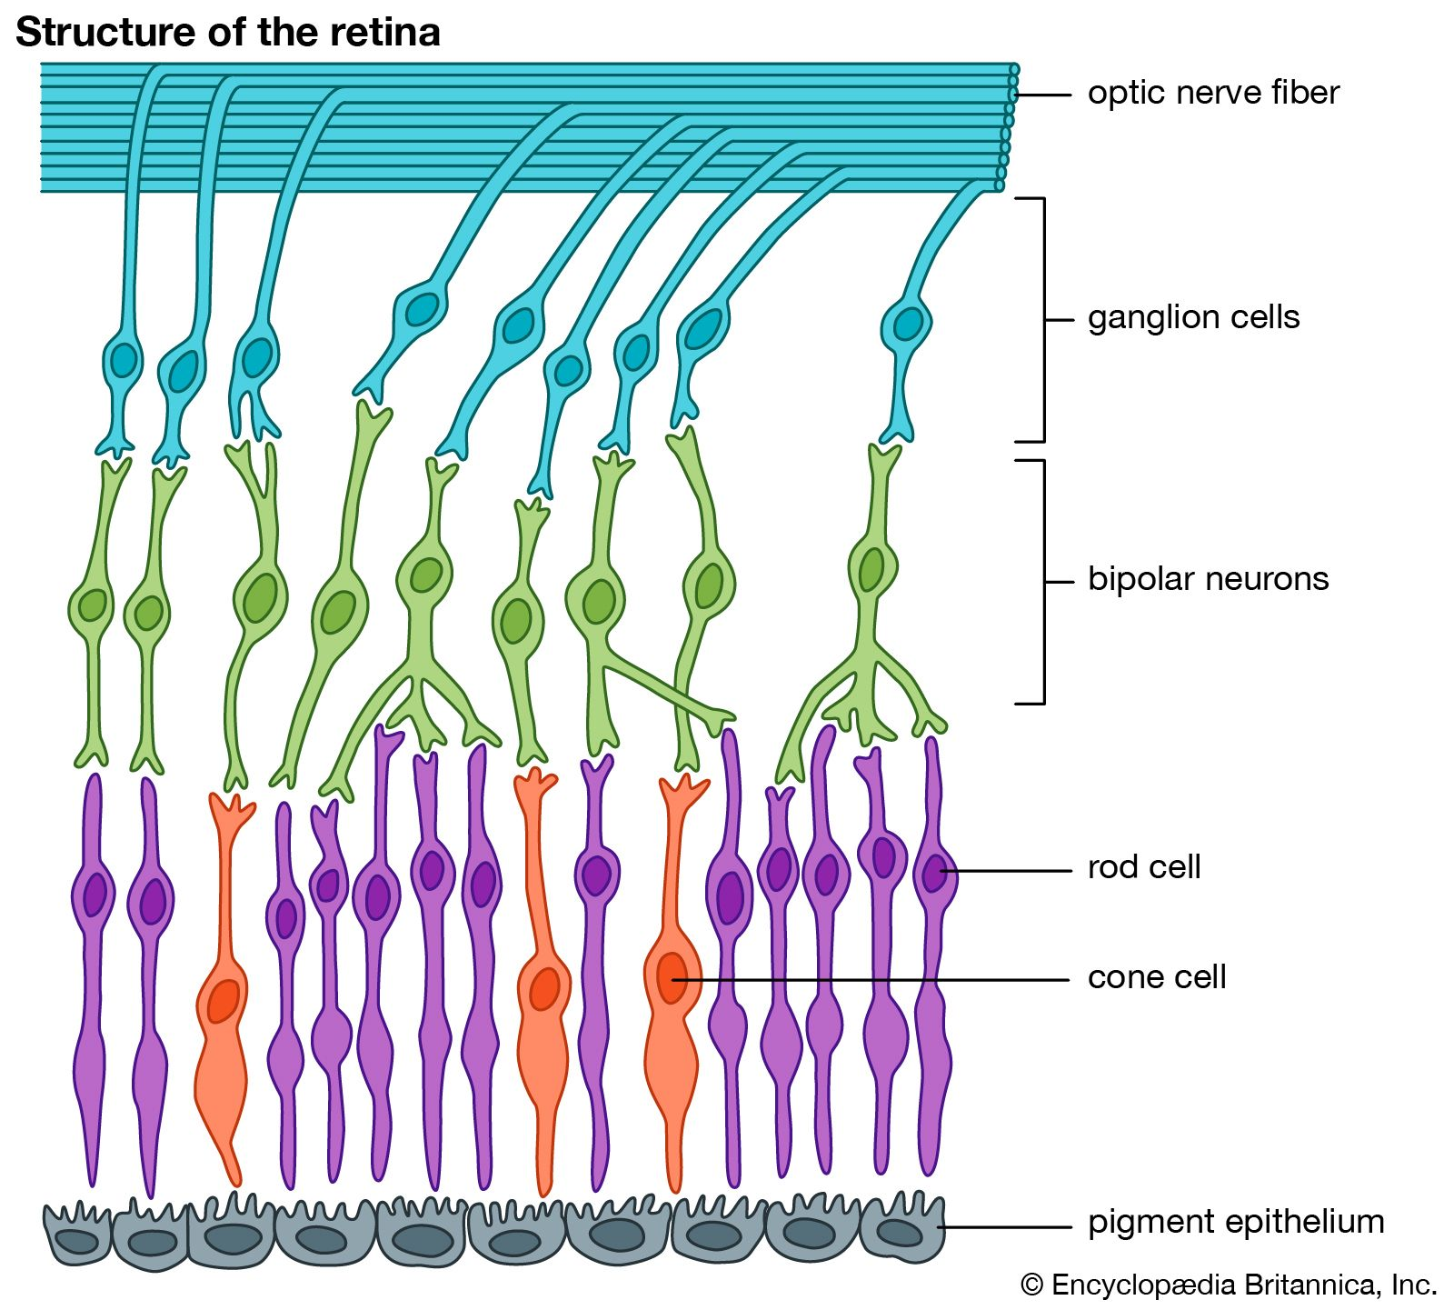

Slide 3
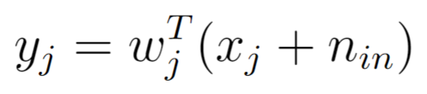
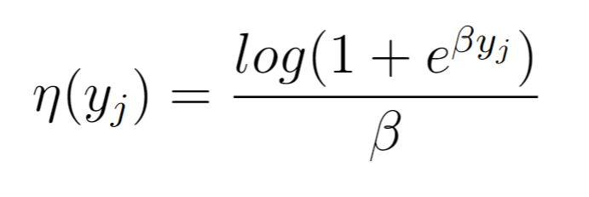
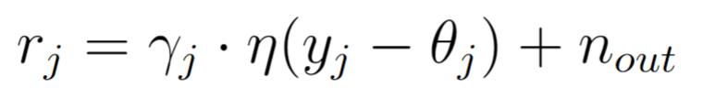
Forward model in 3 easy steps
1- Linear weighted inputs
2- Softplus output nonlinearity
3- Gain and threshold

Slide 4
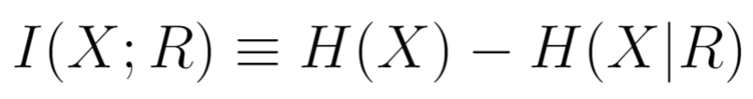
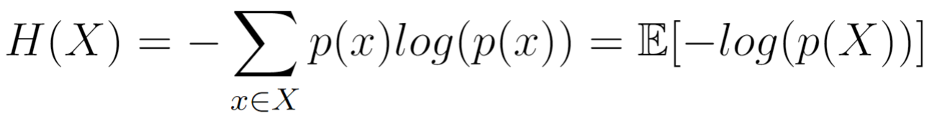
Maximizing mutual information

Slide 5
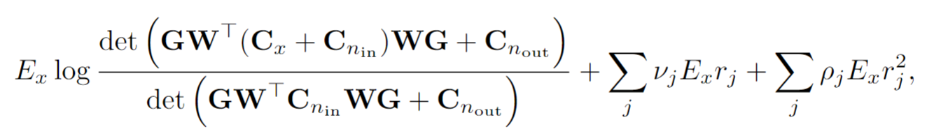
Firing rate constraint – Lagrange multipliers

Slide 6
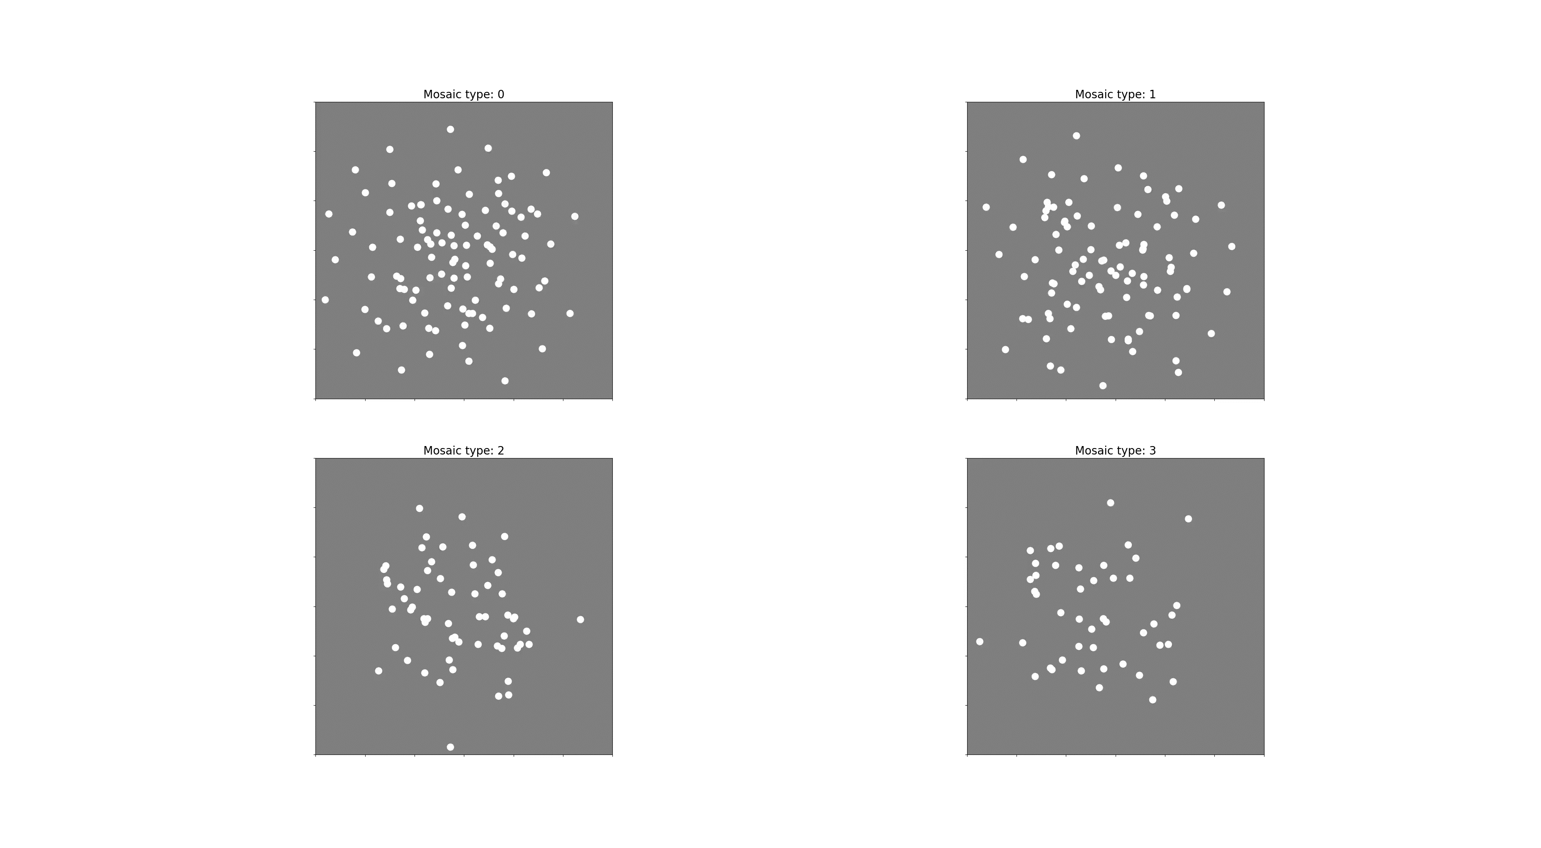
“Mosaics” I’ve been getting for the past year (3-channels)

Slide 7
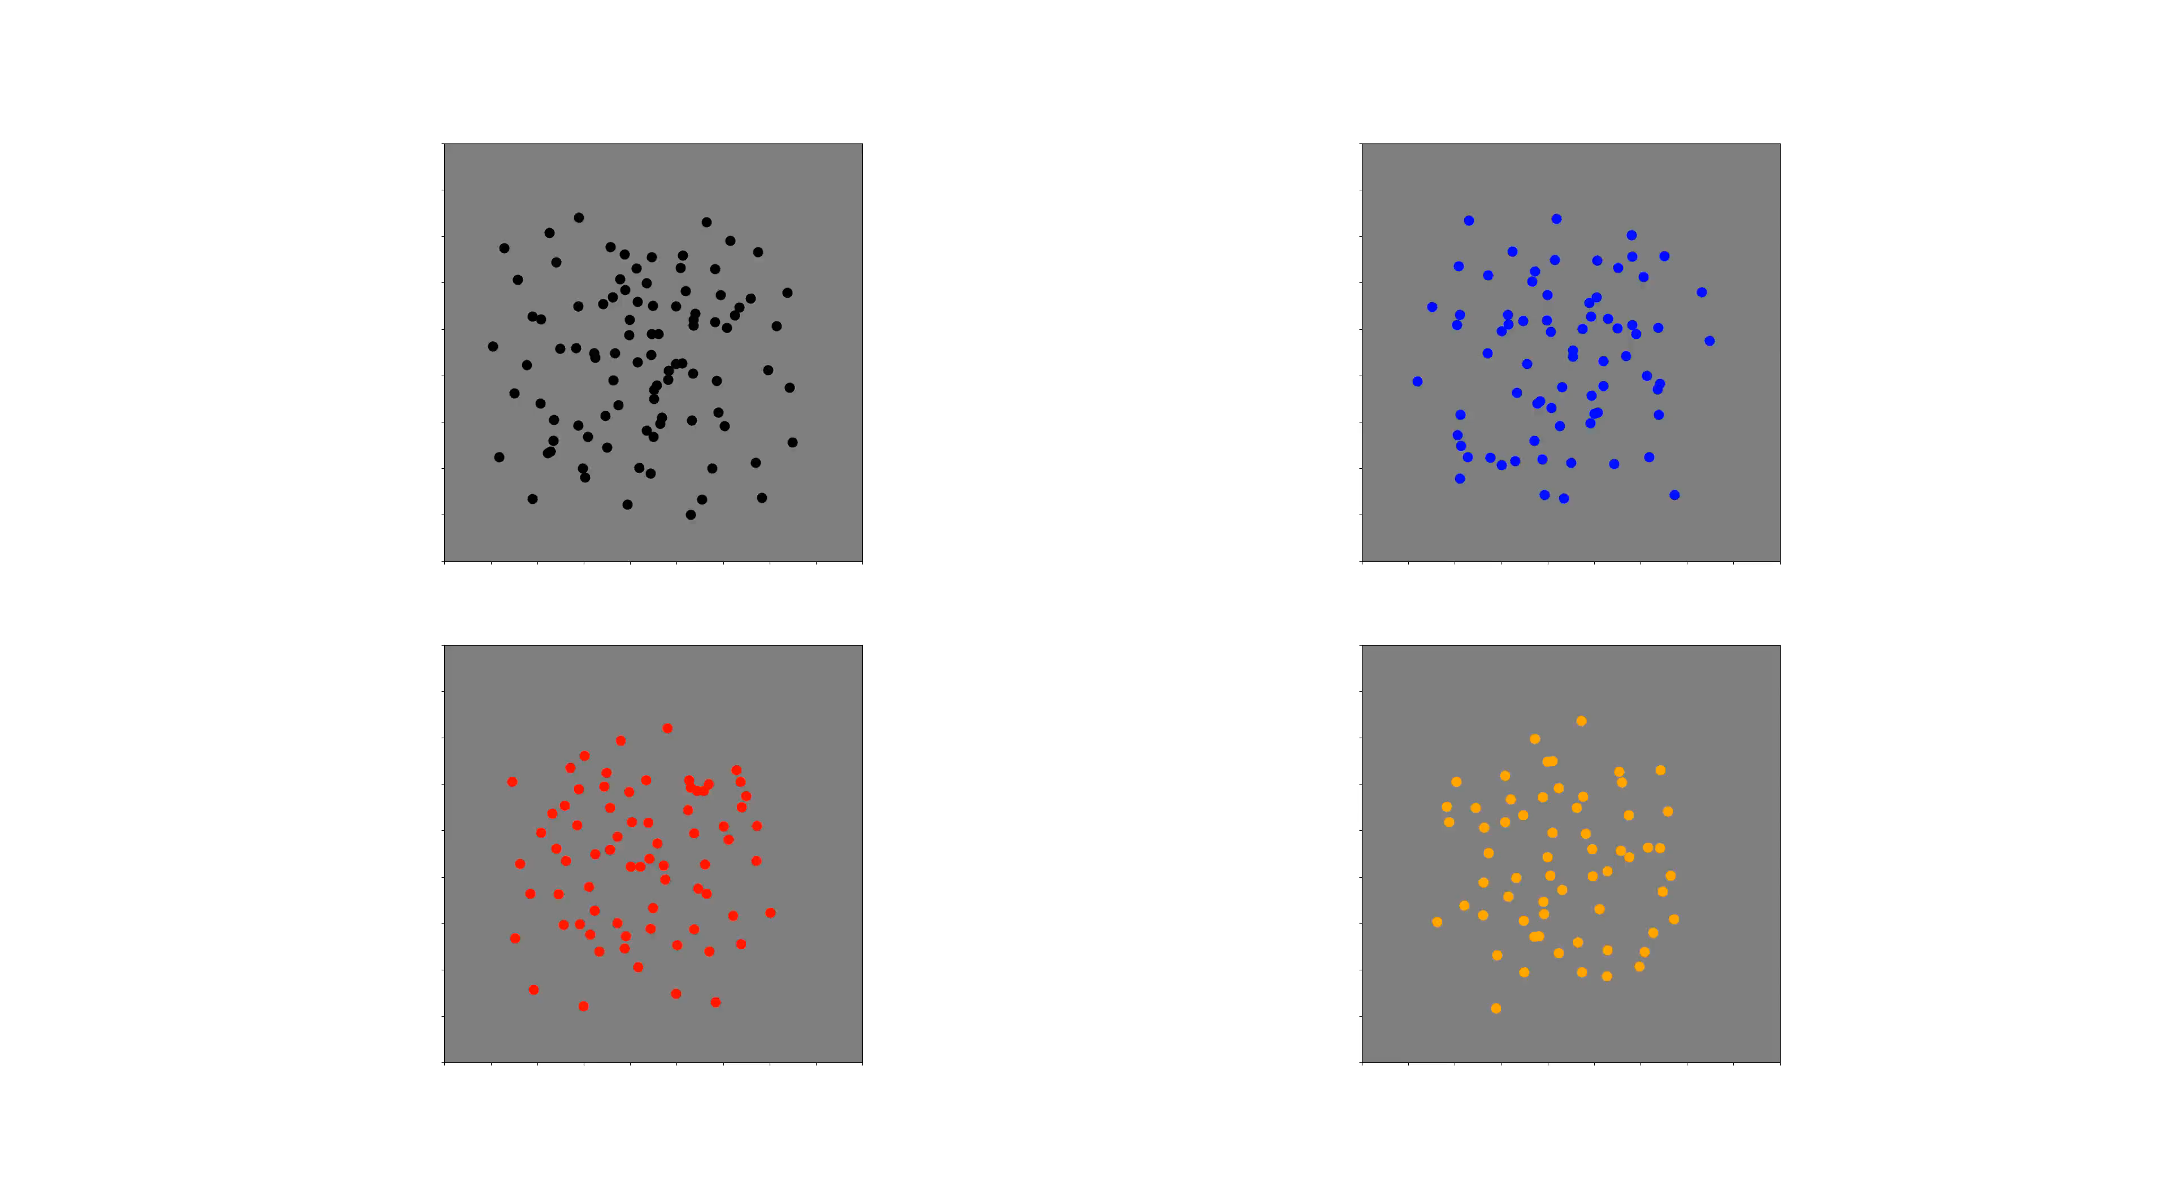
“Mosaics” I’m getting now (2-channels)

Slide 8
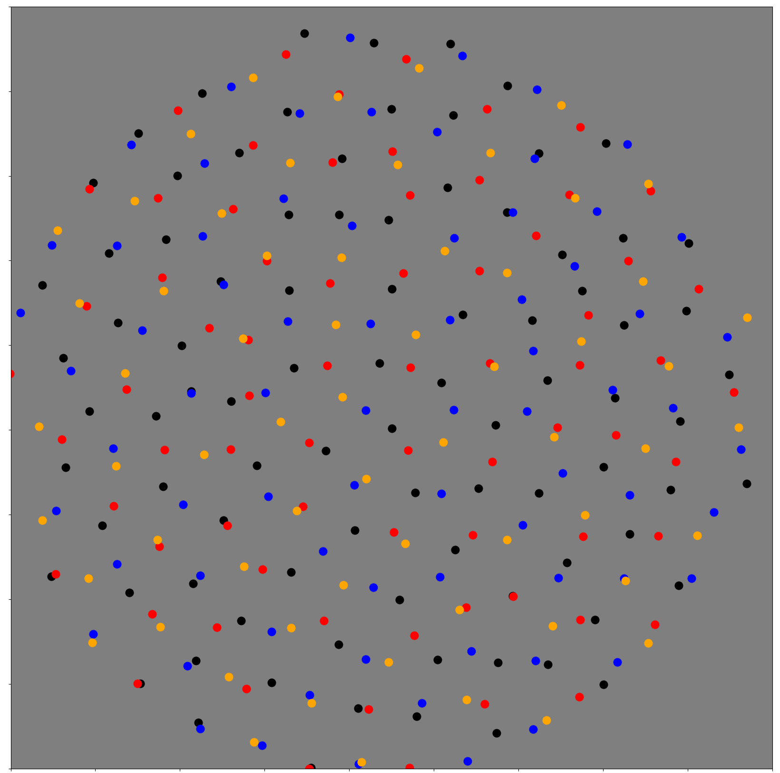

Slide 9
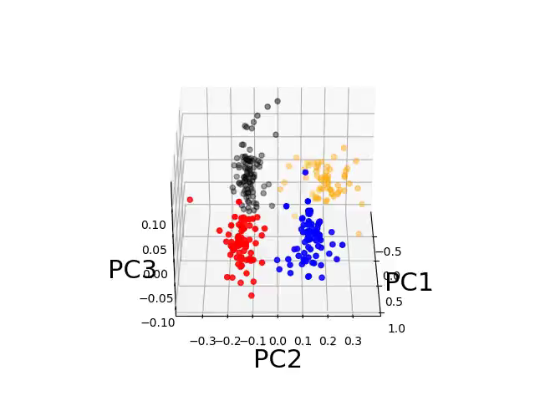

Slide 10
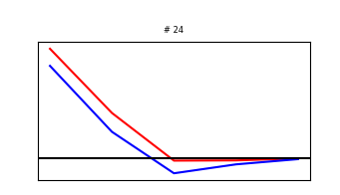
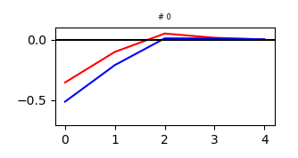
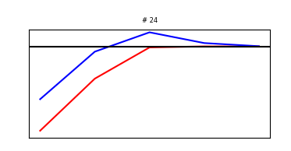
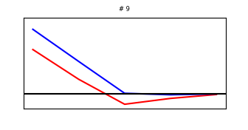
Radial averages for the 4 mosaics

Slide 11
These EC receptive fields are not fully representative of retinal receptive fields
There are indeed cells (Parasol) that add color channels (+L +S or –L –S)
However, other cell types (e.g. bistratified) are color opponent (+S –L).

Slide 12
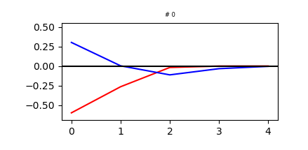
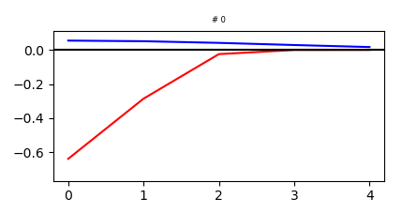
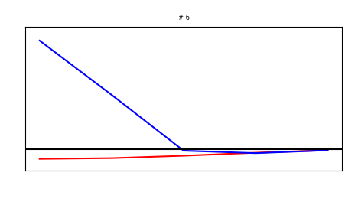
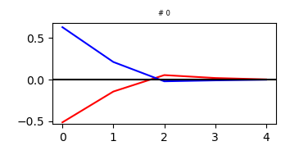
We can get color-opponency by doing changes and re-training the model
Manipulation
Training

Slide 13
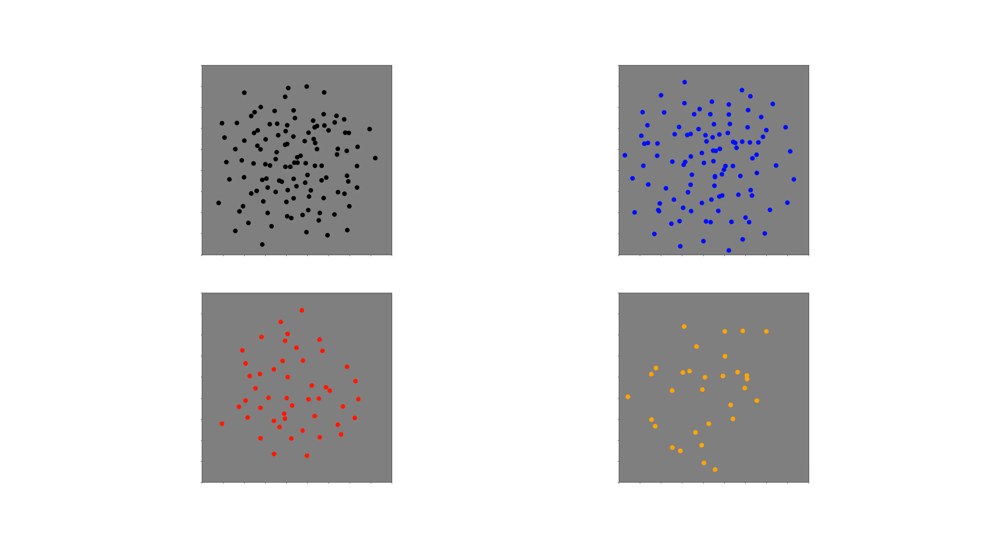
Mosaics are still clean

Slide 14
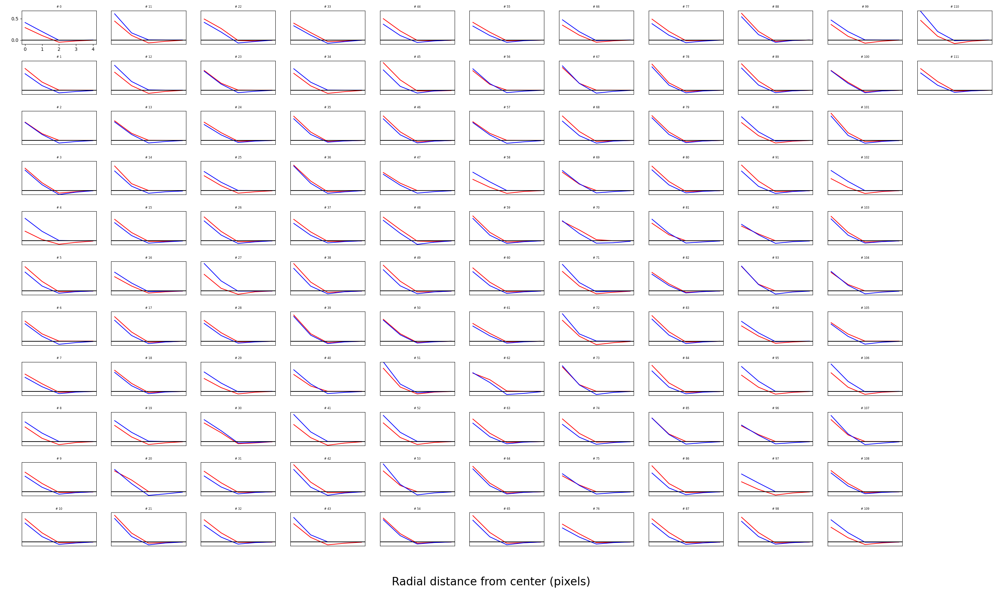
First mosaic

Slide 15
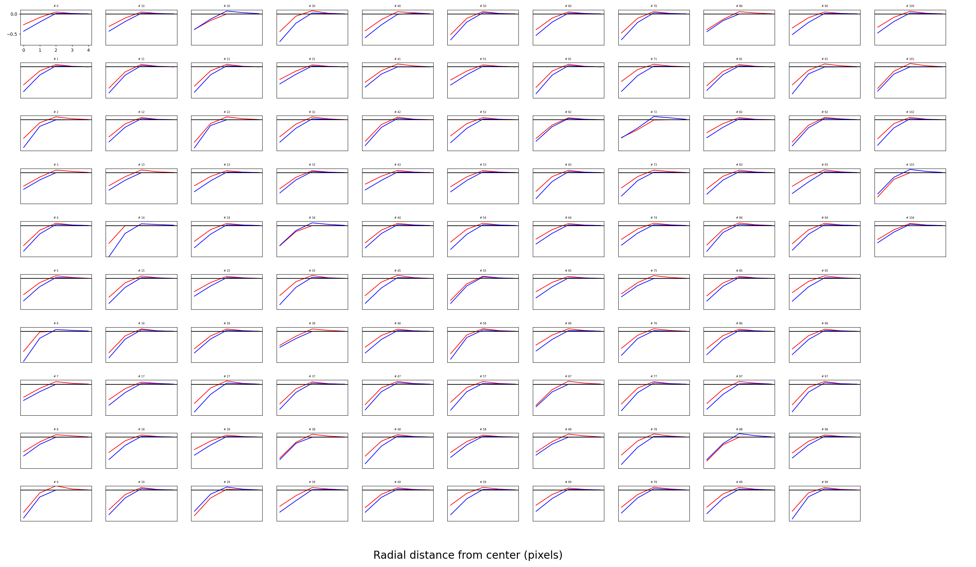
Second mosaic

Slide 16
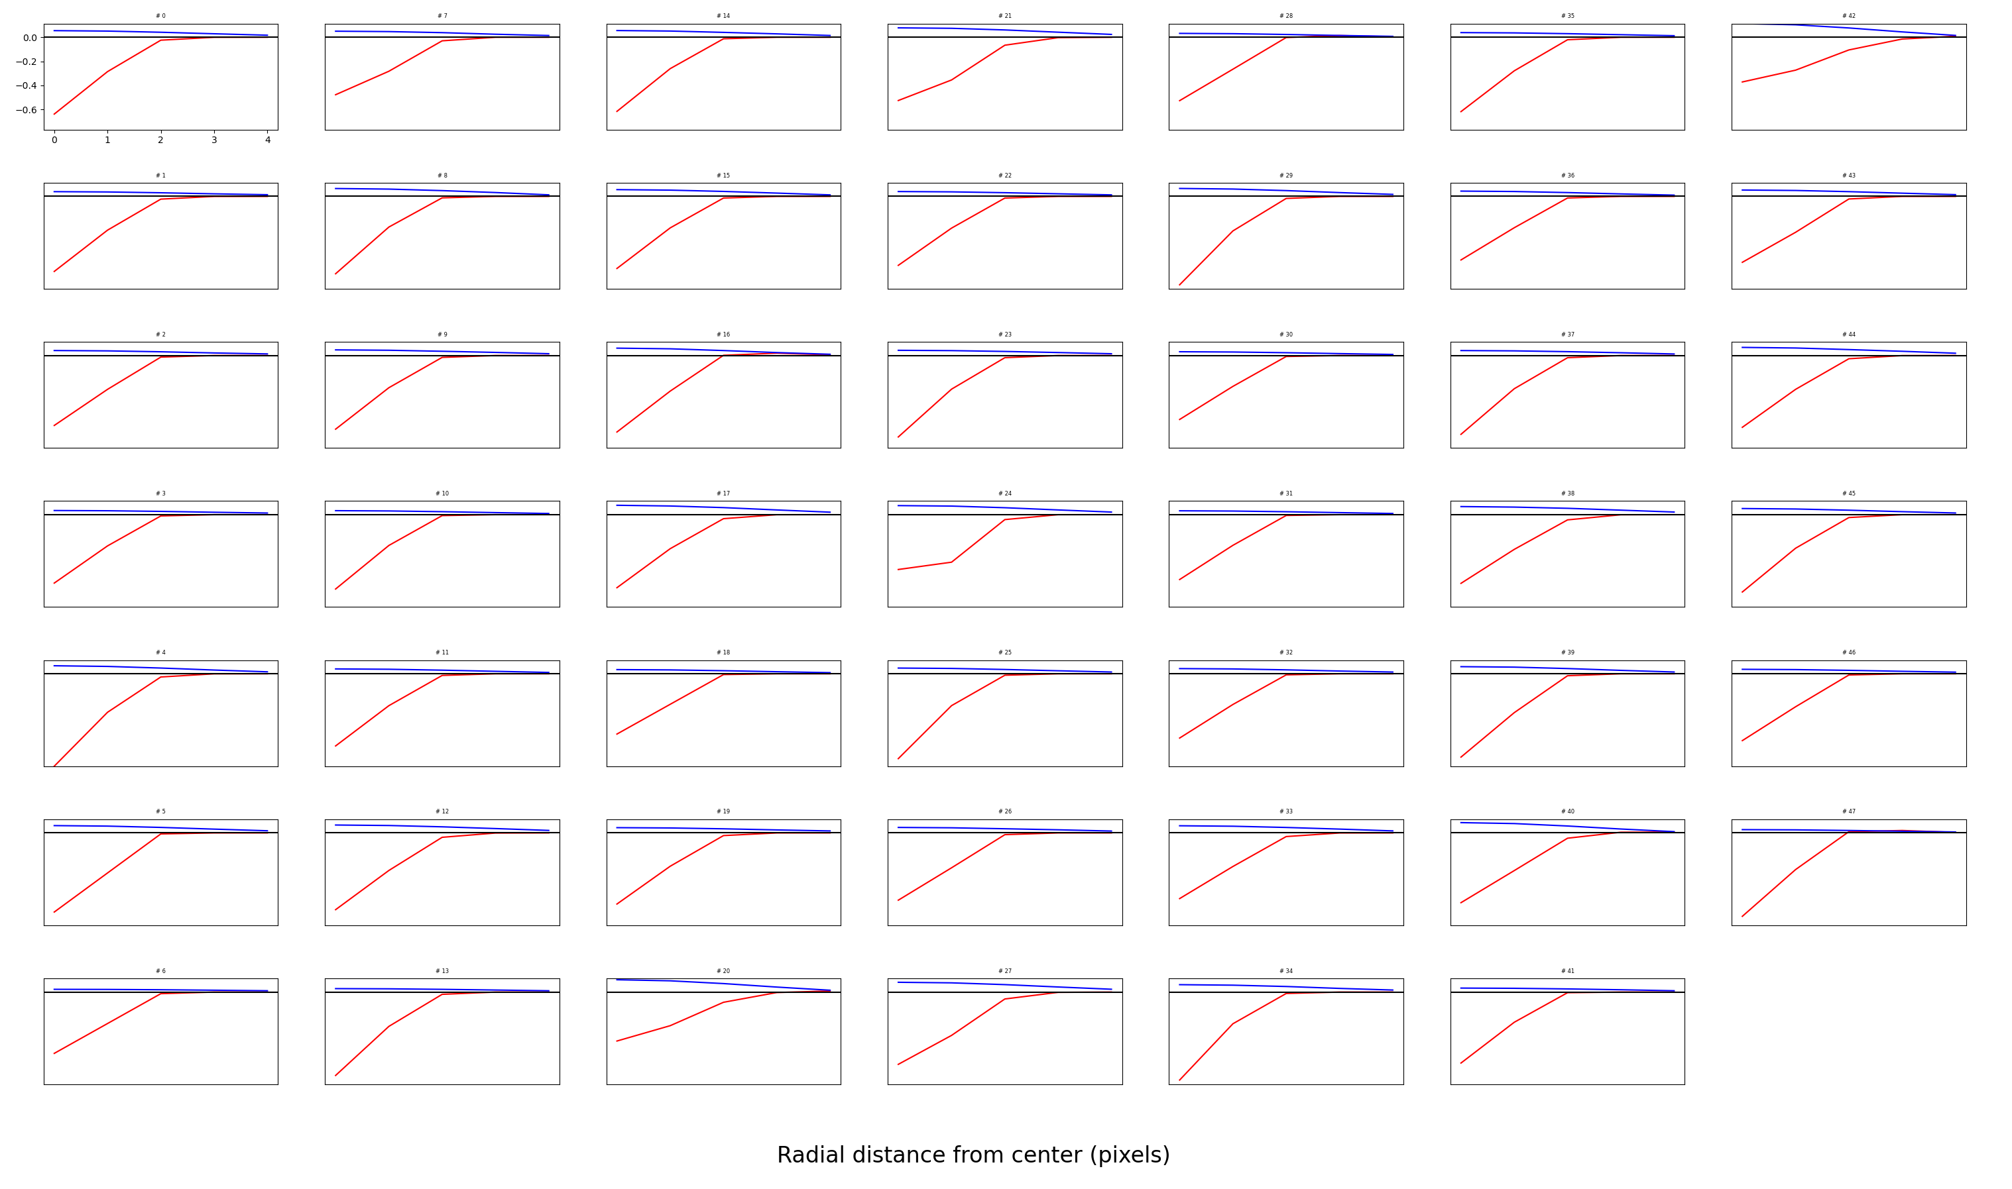
Third mosaic

Slide 17
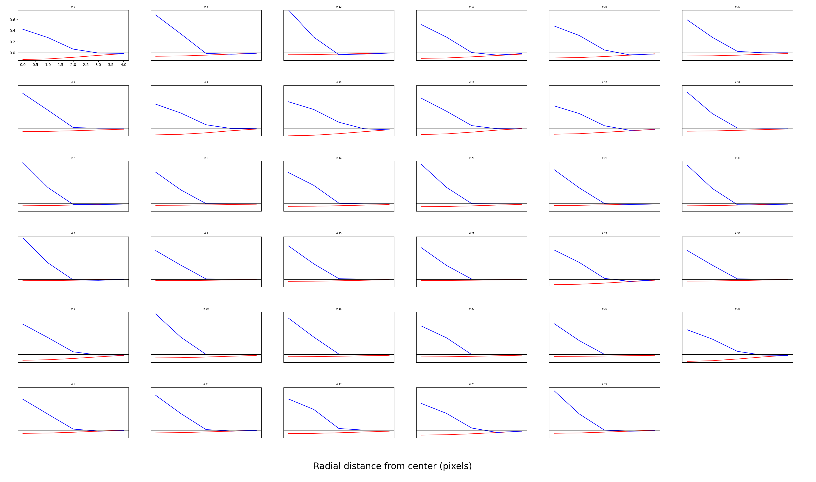
Fourth mosaic

Slide 18
Neurons “hop” mosaics to the first two
Prior to changes, number of neurons in each mosaic was similar
After changes, roughly all neurons in the first two mosaics remained in the same mosaic
33% of neurons in the L OFF mosaic went to the regular OFF Mosaic.
50% of neurons in the S ON cluster went to the regular ON cluster.

Slide 19
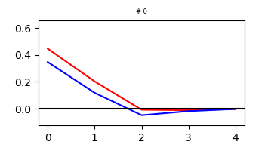
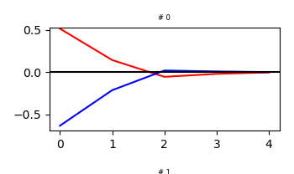
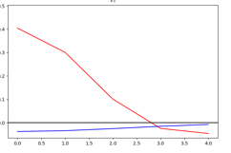
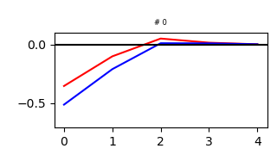
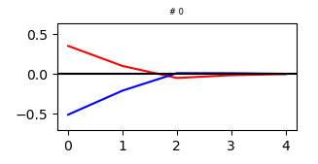
Can we get +S mosaics? Not really
Manipulation
Training

Slide 20
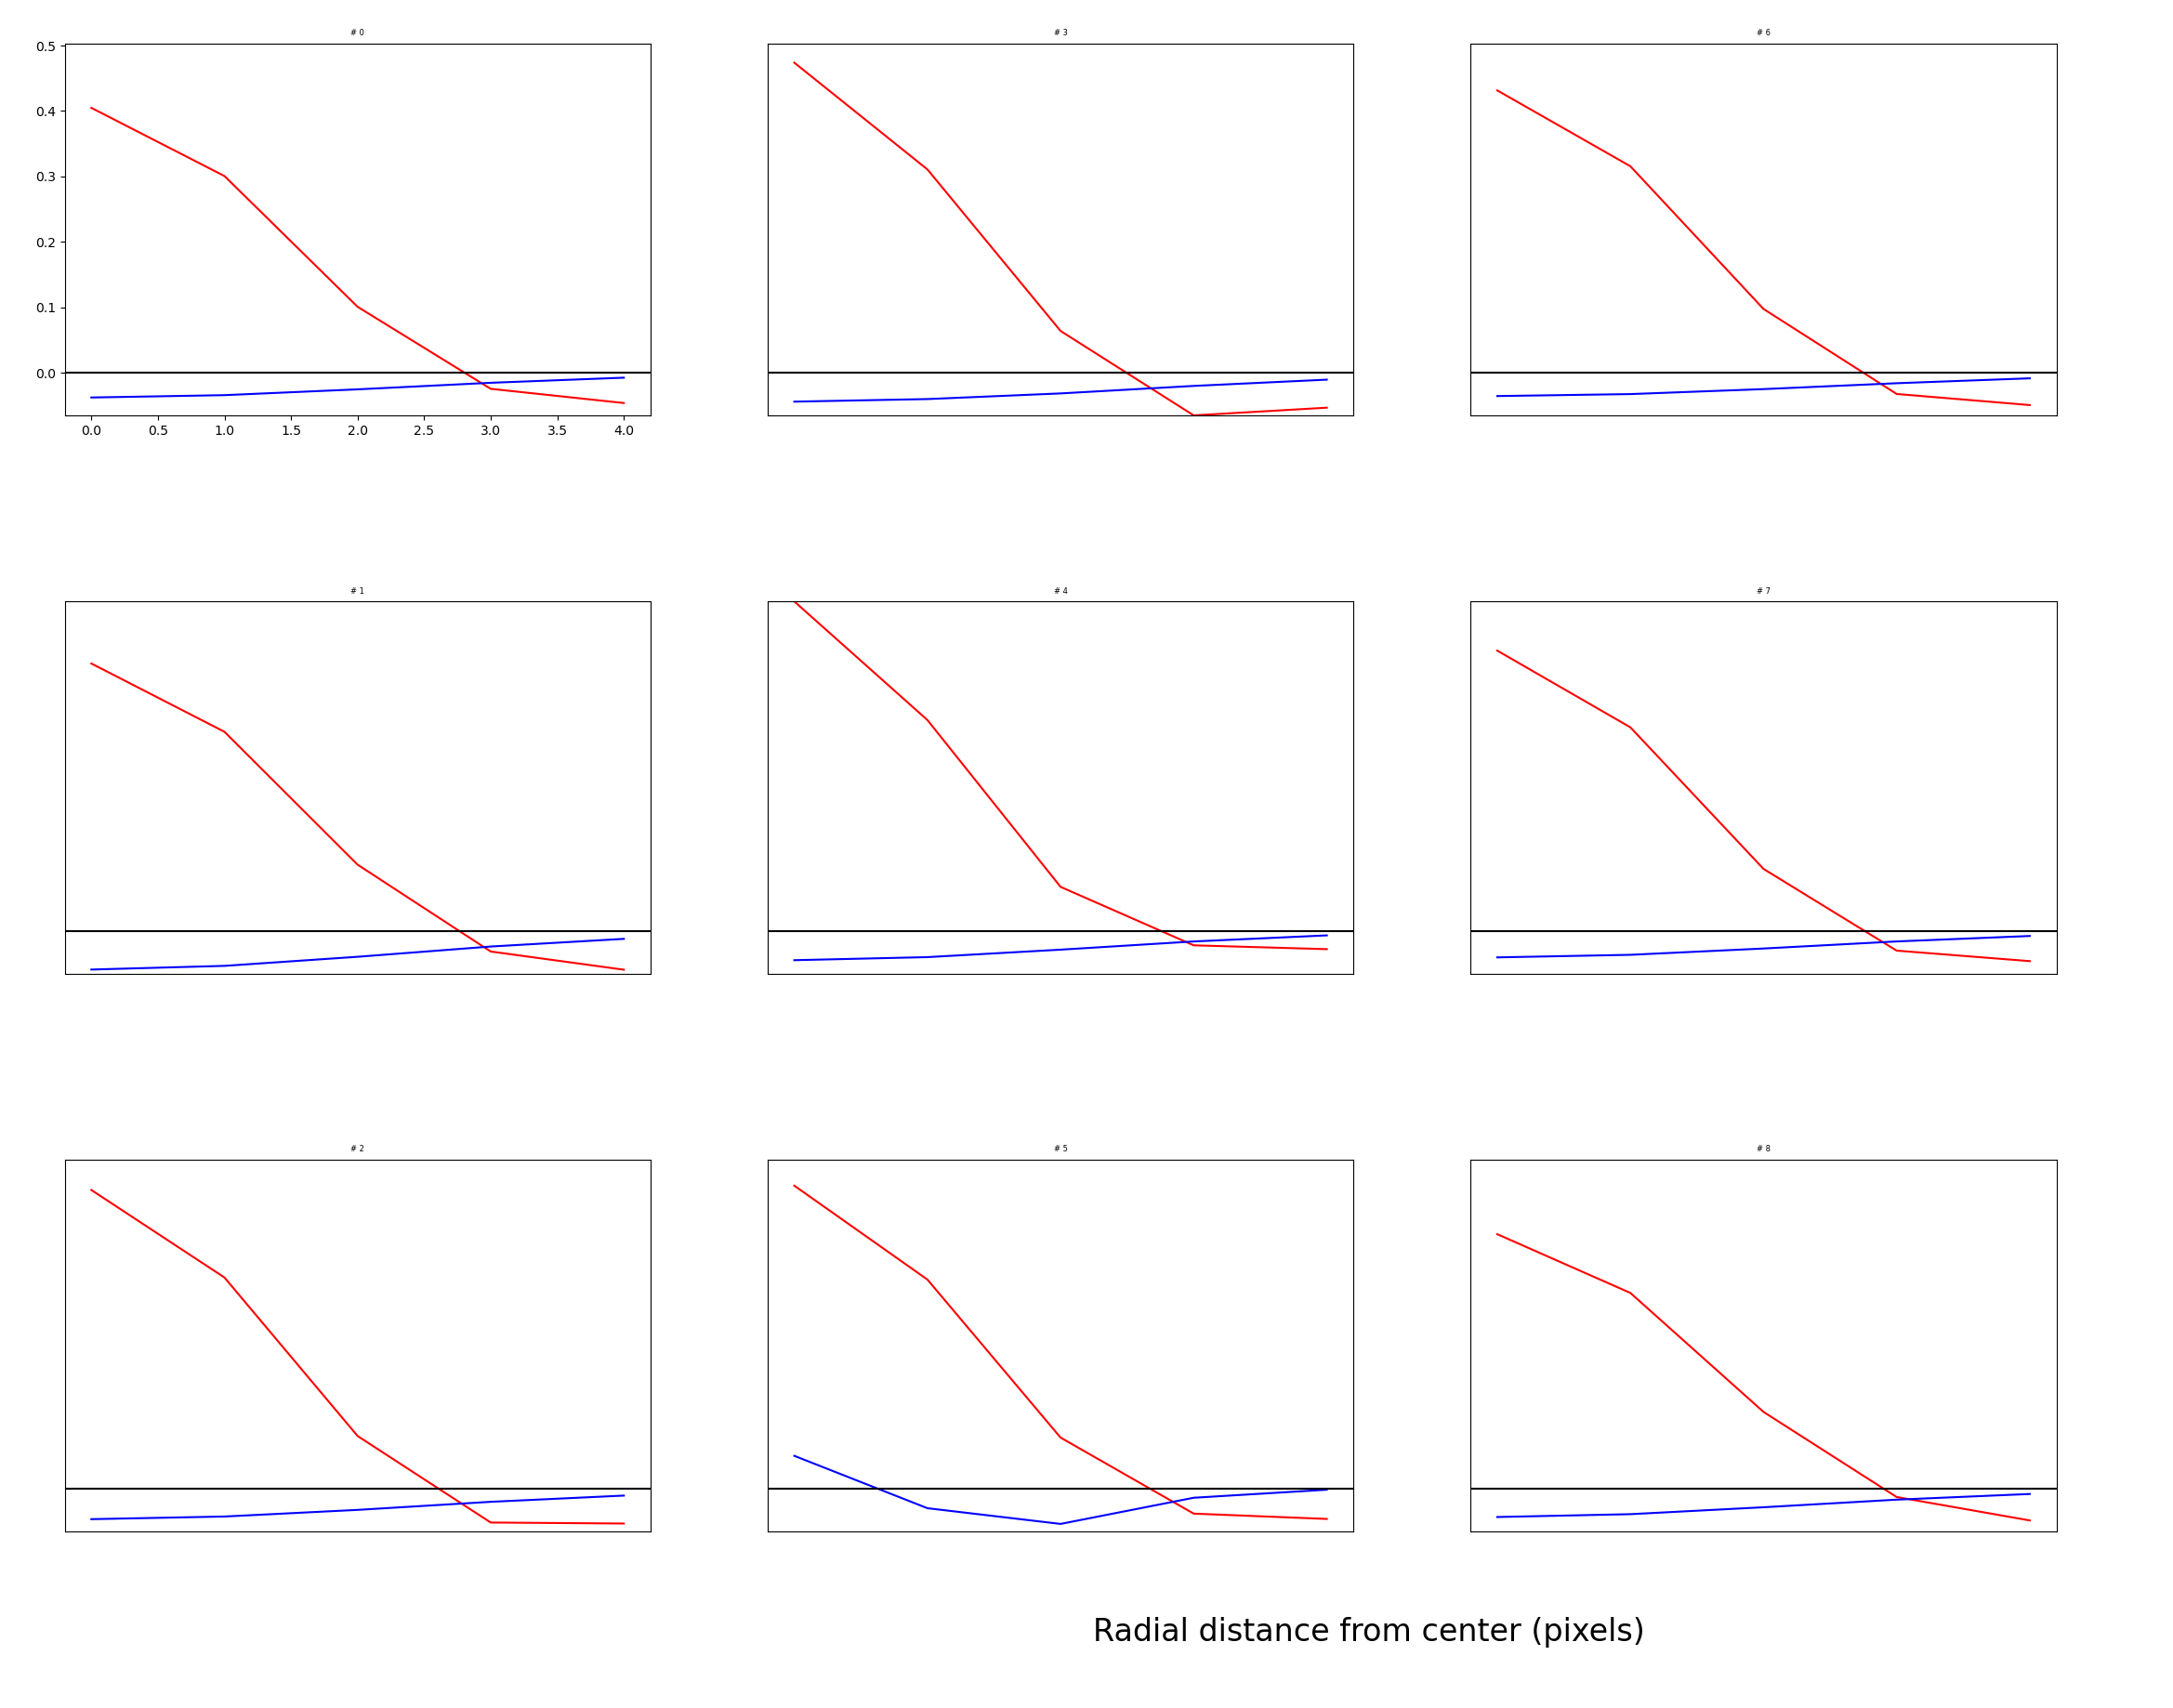

Slide 21
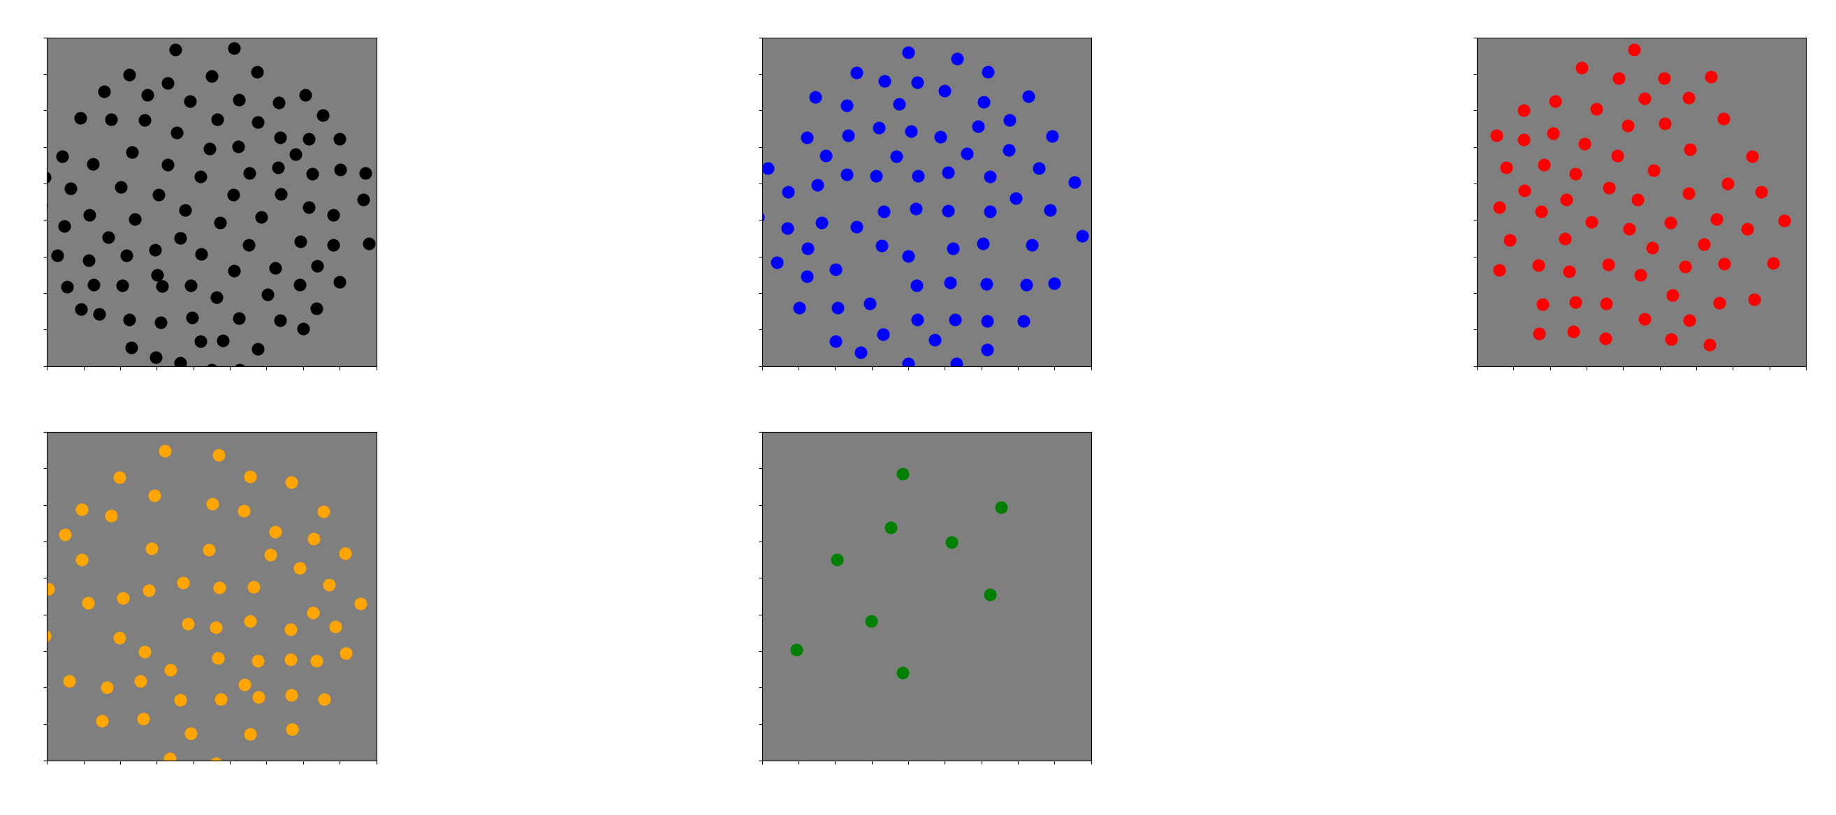

Slide 22
Next steps
Try to figure out why there is this asymmetry between –L/+S and +L/-S mosaics
Analyze natural images
“Loss of function” experiments

